Slide 1
Introduction to SQL

Slide 2
History
IBM Sequel language developed as part of System R project at the IBM San Jose Research Laboratory
Renamed Structured Query Language (SQL)
ANSI and ISO standard SQL:
SQL-86
SQL-89
SQL-92
SQL:1999 (language name became Y2K compliant!)
SQL:2003
Commercial systems offer most, if not all, SQL-92 features, plus varying feature sets from later standards and special proprietary features.
Not all examples here may work on your particular system.

Slide 3
SQL Parts
DML -- provides the ability to query information from the database and to insert tuples into, delete tuples from, and modify tuples in the database.
integrity – the DDL includes commands for specifying integrity constraints.
View definition -- The DDL includes commands for defining views.
Transaction control –includes commands for specifying the beginning and ending of transactions.
Embedded SQL and dynamic SQL -- define how SQL statements can be embedded within general-purpose programming languages.
Authorization – includes commands for specifying access rights to relations and views.

Slide 4
Data Definition Language
The SQL data-definition language (DDL) allows the specification of information about relations, including:
The schema for each relation.
The type of values associated with each attribute.
The Integrity constraints
The set of indices to be maintained for each relation.
Security and authorization information for each relation.

Slide 5
Domain Types in SQL
char(n). Fixed length character string, with user-specified length n.
varchar(n). Variable length character strings, with user-specified maximum length n.
int. Integer (a finite subset of the integers that is machine-dependent).
smallint. Small integer (a machine-dependent subset of the integer domain type).
numeric(p,d). Fixed point number, with user-specified precision of p digits, with d digits to the right of decimal point. (ex., numeric(3,1), allows 44.5 to be stores exactly, but not 444.5 or 0.32)
real, double precision. Floating point and double-precision floating point numbers, with machine-dependent precision.
float(n). Floating point number, with user-specified precision of at least n digits.
More are covered in Chapter 4.

Slide 6
Create Table Construct
An SQL relation is defined using the create table command:
create table r
(A₁ D₁, A₂ D₂, ..., A_{n} D_{n}, (integrity-constraint₁), ..., (integrity-constraint_{k}))
r is the name of the relation
each A_{i} is an attribute name in the schema of relation r
D_{i} is the data type of values in the domain of attribute A_{i}
Example:
create table instructor ( ID char(5), name varchar(20), dept_name varchar(20), salary numeric(8,2))

Slide 7
Updates to tables
Insert
insert into instructor values (‘10211’, ’Smith’, ’Biology’, 66000);
Delete
Remove all tuples from the student relation
delete from student
Drop Table
drop table r
Alter
alter table r add A D
where A is the name of the attribute to be added to relation r and D is the domain of A.
All exiting tuples in the relation are assigned null as the value for the new attribute.
alter table r drop A
where A is the name of an attribute of relation r
Dropping of attributes not supported by many databases.

Slide 8
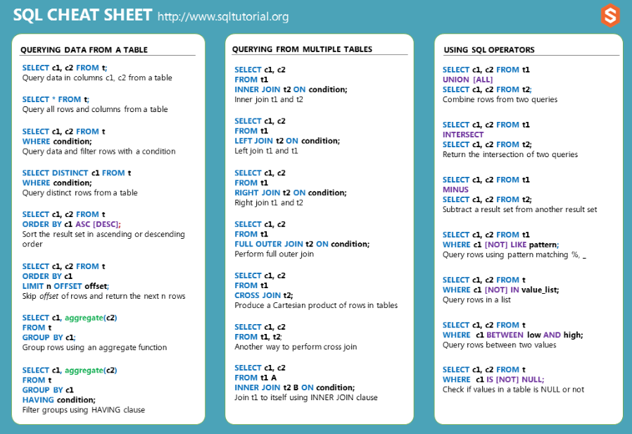
Preview SQL
sqltutorial.org/sql-cheat-sheet

Slide 9
Basic Query Structure
A typical SQL query has the form: select A₁, A₂, ..., A_{n} from r₁, r₂, ..., r_{m} where P
A_{i} represents an attribute
R_{i} represents a relation
P is a predicate.
Call this a SFW query.
The result of an SQL query is a relation.
Notes:
2

Slide 10
The select Clause
The select clause lists the attributes desired in the result of a query
corresponds to the projection operation of the relational algebra
Example: find the names of all instructors: select name from instructor
NOTE: SQL names are case insensitive (i.e., you may use upper- or lower-case letters.)
E.g., Name ≡ NAME ≡ name
Some people use upper case wherever we use bold font.
Values are not:
Different: ‘Seattle’, ‘seattle’
Use single quotes for constants:
‘abc’ - yes
“abc” - no
Notes:
3

Slide 11
The select Clause (Cont.)
SQL allows duplicates in relations as well as in query results.
To force the elimination of duplicates, insert the keyword distinct after select.
Find the department names of all instructors, and remove duplicates
select distinct dept_name from instructor
The keyword all specifies that duplicates should not be removed.
select all dept_name from instructor
Notes:
4

Slide 12
The select Clause (Cont.)
An asterisk in the select clause denotes “all attributes”
select * from instructor
An attribute can be a literal with from clause
select ‘A’ from instructor
Result is a table with one column and N rows (number of tuples in the instructors table), each row with value “A”
Notes:
5

Slide 13
The where Clause
The where clause specifies conditions that the result must satisfy
Corresponds to the selection predicate of the relational algebra.
To find all instructors in Comp. Sci. dept
select name from instructor where dept_name = ‘Comp. Sci.'
SQL allows the use of the logical connectives and, or, and not
The operands of the logical connectives can be expressions involving the comparison operators <, <=, >, >=, =, and <>.
Comparisons can be applied to results of arithmetic expressions
To find all instructors in Comp. Sci. dept with salary > 80000
select name from instructor where dept_name = ‘Comp. Sci.' and salary > 80000
Notes:
6

Slide 14
The from Clause
The from clause lists the relations involved in the query
Corresponds to the Cartesian product operation of the relational algebra.
Find the Cartesian product instructor X teaches
select ∗ from instructor, teaches
generates every possible instructor – teaches pair, with all attributes from both relations.
For common attributes (e.g., ID), the attributes in the resulting table are renamed using the relation name (e.g., instructor.ID)
Cartesian product not very useful directly, but useful combined with where-clause condition (selection operation in relational algebra).
Notes:
8

Slide 15
Examples
Find the names of all instructors who have taught some course and the course_id
select name, course_id from instructor , teaches where instructor.ID = teaches.ID
Find the names of all instructors in the Art department who have taught some course and the course_id
select name, course_id from instructor , teaches where instructor.ID = teaches.ID and instructor. dept_name = ‘Art’
Notes:
9

Slide 16
The Rename Operation
The SQL allows renaming relations and attributes using the as clause:
old-name as new-name
Find the names of all instructors who have a higher salary than some instructor in ‘Comp. Sci’.
select distinct T.name from instructor as T, instructor as S where T.salary > S.salary and S.dept_name = ‘Comp. Sci.’
Keyword as is optional and may be omitted instructor as T ≡ instructor T
Notes:
9

Slide 17
Ordering the Display of Tuples
List in alphabetic order the names of all instructors
select distinct name from instructor order by name
We may specify desc for descending order or asc for ascending order, for each attribute; ascending order is the default.
Example: order by name desc
Can sort on multiple attributes
Example: order by dept_name, name

Slide 18
Null Values
It is possible for tuples to have a null value, denoted by null, for some of their attributes
null signifies an unknown value or that a value does not exist.
The result of any arithmetic expression involving null is null
Example: 5 + null returns null
The predicate is null can be used to check for null values.
Example: Find all instructors whose salary is null.
select name from instructor where salary is null
The predicate is not null succeeds if the value on which it is applied is not null.

Slide 19
Null Values (Cont.)
SQL treats as unknown the result of any comparison involving a null value (other than predicates is null and is not null).
Example: 5 < null or null <> null or null = null
The predicate in a where clause can involve Boolean operations (and, or, not); thus the definitions of the Boolean operations need to be extended to deal with the value unknown.
and : (true and unknown) = unknown, (false and unknown) = false, (unknown and unknown) = unknown
or: (unknown or true) = true, (unknown or false) = unknown (unknown or unknown) = unknown
Result of where clause predicate is treated as false if it evaluates to unknown

Slide 20
Aggregate Functions
These functions operate on the multiset of values of a column of a relation, and return a value
avg: average value min: minimum value max: maximum value sum: sum of values count: number of values
Produce numbers (not tables)
Aggregates over multiple rows into one row
Not part of relational algebra (but not hard to add)

Slide 21
Aggregate Functions Examples
Find the average salary of instructors in the Computer Science department
select avg (salary) from instructor where dept_name= ’Comp. Sci.’;
Find the total number of instructors who teach a course in the Spring 2010 semester
select count (distinct ID) from teaches where semester = ’Spring’ and year = 2018;
Find the number of tuples in the course relation
select count (*) from course;

Slide 22
Aggregation
Product(PName, Price, Category, Year, Maker)
select AVG(price)
from Product
where maker = “Toyota”
select COUNT(*)
from Product
where year > 1995
Except COUNT, all aggregations apply to a single attribute
Question: count(*) vs. count(price)?

Slide 23
Simple Aggregations
Purchase
Product | Date | Price | Quantity
bagel | 10/21 | 1 | 20
banana | 10/3 | 0.5 | 10
banana | 10/10 | 1 | 10
bagel | 10/25 | 1.50 | 20
SELECT SUM(price * quantity)
FROM Purchase
WHERE product = ‘bagel’
50 (= 1*20 + 1.50*20)

Slide 24
End

